Slide 1
Stanley Consolidated School
High School Assembly
April 7, 2022

Slide 2
Welcome!
Goals for this assembly:
To respond to student needs and help your voices be heard.
To clarify how to use school spaces and resources appropriately.
To explain school expectations for breaks and lunch.
To share information about how to get help if you are struggling at school

Slide 3
General School Rules
Be Responsible
Be Safe
Be Respectful
Be Kind

Slide 4
Student Concerns
We have heard you and want to make some changes!

Slide 5
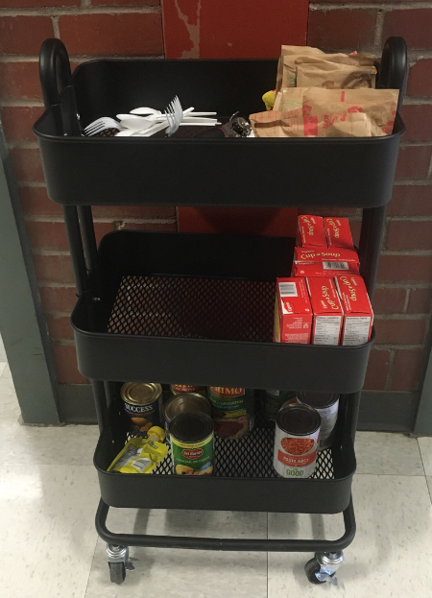
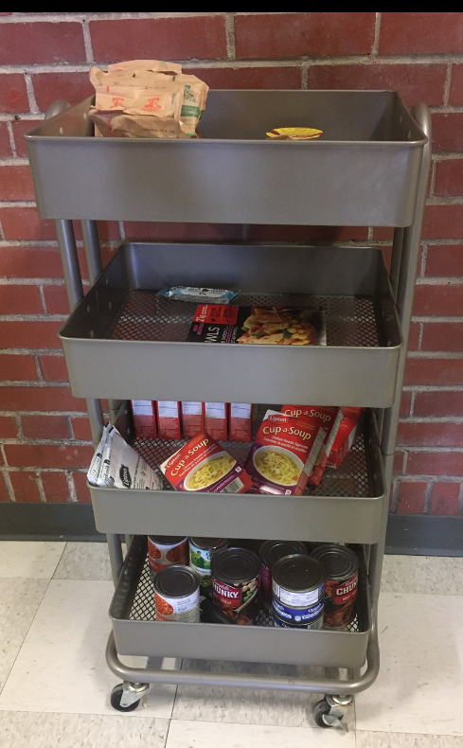
Breakfast Baskets, Food Carts and SCS Essentials Room
Food is available for all students throughout the day.
Use what you need and be mindful of others’ needs.
Garbage
Be respectful

Slide 6
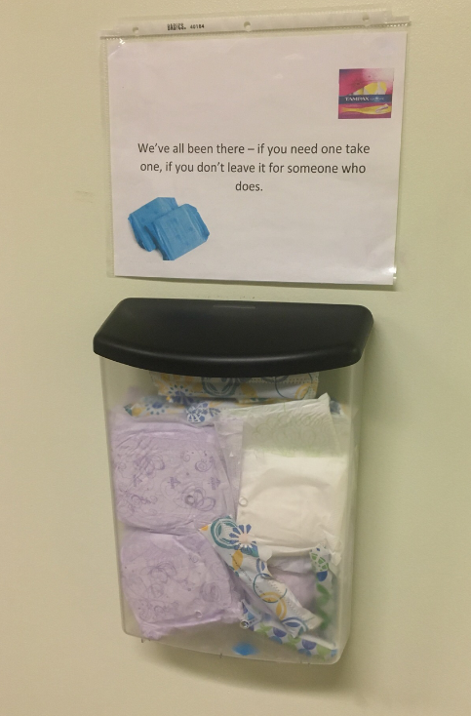
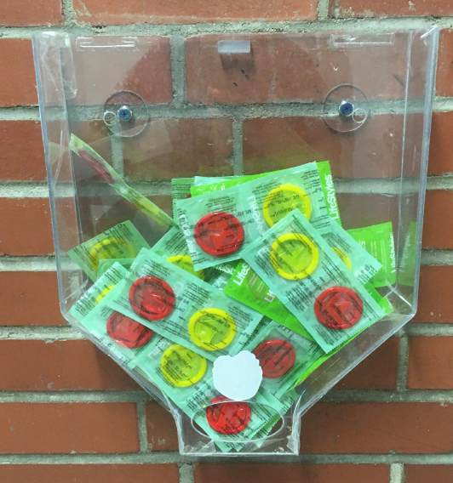
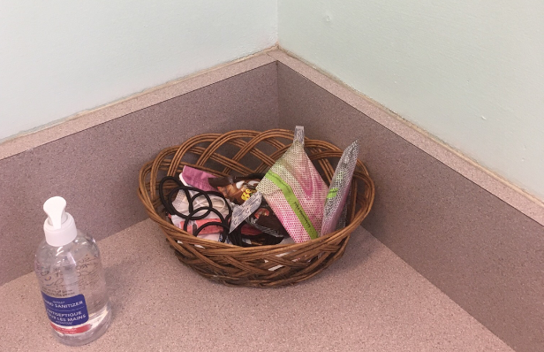
Other Free Stuff
Condoms
Feminine Hygiene Products
Hygiene Care Packages
Other Essential items available

Slide 7
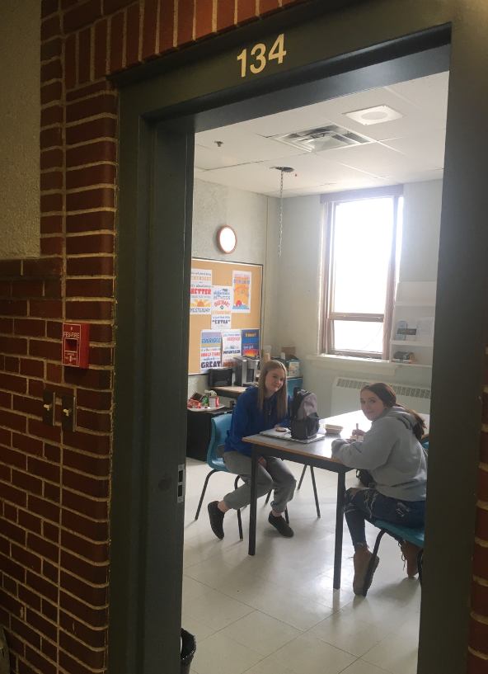
New Work Space
Door MUST remain open
Teacher permission required for use during class time. Only one person allowed at a time during class.
No more than 8-10 people in the room at once during breaks and lunch.
Clean up after yourself (i.e. throw your own garbage away, put things back where you found them, etc)

Slide 8
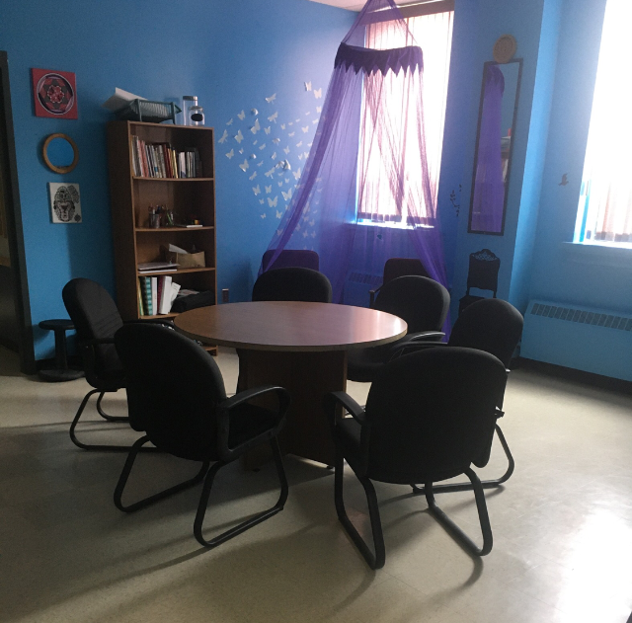
Blue Room
Main purpose = safe place if experiencing difficulty (i.e. anxiety, depression, peer conflict, strong emotions, feelings of overwhelm, etc)
Doors MUST remain open unless Ms. Lanteigne closes them
If the doors are closed, you need to find an alternative space (new Work Space)
Teacher permission required prior to use (We MUST know where you are at all times). Only one person allowed at a time during class.
Clean up after yourself
No use of the staff room, attached bathroom and offices
No more than 8-10 people during breaks and lunch

Slide 9
During Class
You are expected to be in your classroom for the entire 60 minutes.
The goal of school is learning. Keep drama, peer conflict, and friend support for designated unstructured times (10:40-11 and 12:00-12:35).
If you need a break, ask teacher for permission to go for a drink, use the bathroom or work in an alternate space (i.e new work space, blue room, adjoining classroom)
If you arrive to school after the bell or want to leave sign-in/out accordingly.

Slide 10
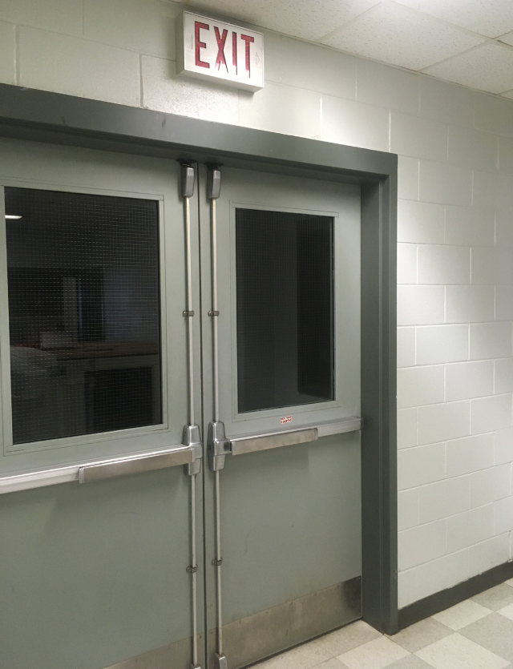
Back Stairwell by the Shop
It is now open and the doors will be open and the lights on.
This is not a hang out spot and is used to change locations from upstairs to downstairs.
Can be used to exit the building. However, you are not able to enter the building using this door. This means it cannot be propped open at any time.

Slide 11
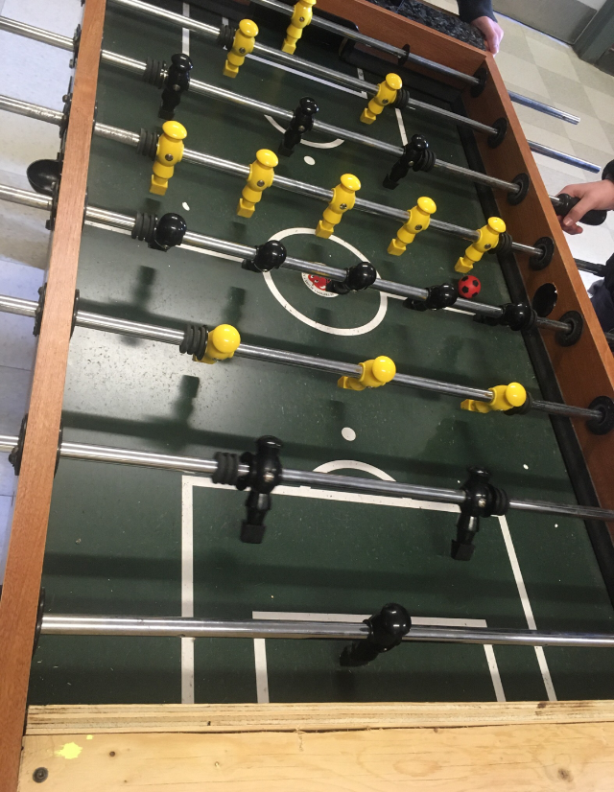
Hallways and Foosball
Used to transition between classes. During transitions and class time no foosball permitted.
You are now able to use the hallways and foosball area during nutrition break and lunch for hanging out with people.
This does not include the basement hallways or stairwells.

Slide 12
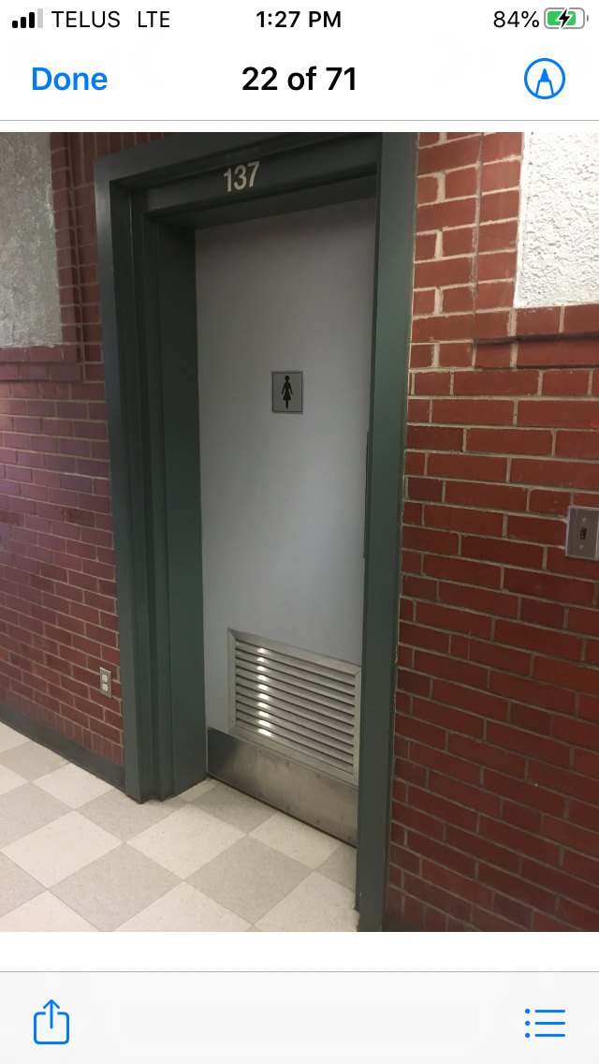
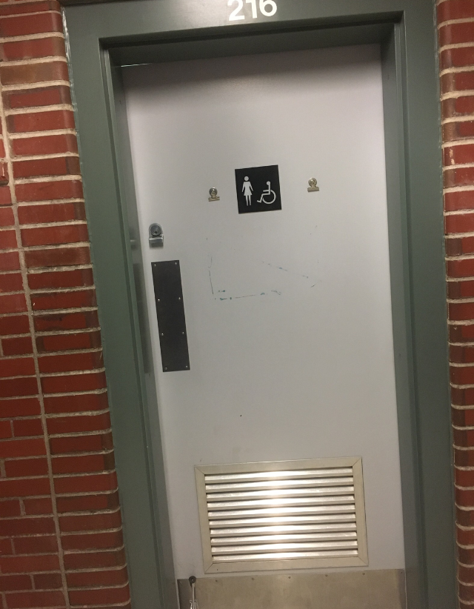
Bathroom Use
Bathrooms are for bowel movements.
This is not a space to hangout or connect with friends.
Vaping will not be tolerated in bathrooms.
All bathrooms are now Middle and High School Bathrooms
Gender neutral bathrooms
No more than 4 people should be in bathroom at any given time.
Adults are able to go into all bathrooms with corresponding gender at any time.

Slide 13
Options for Nutrition Break and Lunch
Cafeteria
Gym
Outside
Computer Lab
Lobby
Library
Hallways
Lounge
Front entrance Lobby
New Work Space
Blue Room
Teacher’s classrooms (if doors are open, you are invited and teacher is in there too)

Slide 14
Areas Off Limits to High School
Basement without a teacher
Elementary Wings
Any classroom without a teacher present
Stairwells
Staff rooms
Photocopier rooms
NOTE: Students should not carry keys at any time. These are for teachers to use only!

Slide 15
Support for SCS
If you or others are struggling:
Talk to an adult
See Ms. Lanteigne
Leave a note for Ms. Lanteigne
Slide an anonymous note under the guidance or office door
Report on PSST World
https://www.psstworld.com/report-it

Slide 16
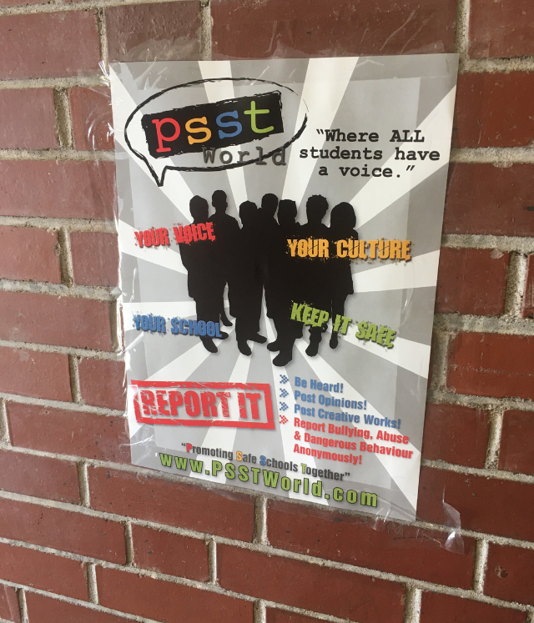

Slide 17
Thanks for listening and have a great day!

